Slide 1
Predicting Hospital Readmission for Patients with Diabetes
March 11th, 2025
Andrew Castillo, Terry Zhuang,
Jiayi Wang, Sarthak Dhanke

Slide 2
Agenda
Problem Statement 3
Class Imbalance & Modeling Approach 8
Hyperparameter Tuning 11
Model Performance Evaluation 17
Implementation Plan 20
Additional Modeling Consideration 22
Understanding hospital readmission in patients with diabetes
Data overview
Data processing & feature engineering
Feature selection
Addressing class imbalance
Model development plan

Slide 3
Problem Statement & Data Overview

Slide 4








The Cost of Hospital Readmissions for Patients with Diabetes
Up to $217,000 annually in Medicare HRRP penalties per hospital
Problem Defined
Hospitals face significant financial and clinical challenges due to 30-day readmissions among patients with diabetes
leading to
Increased patient morbidity
Reduced quality of care
These features potentially play an important role in predicting patient readmission
Feature Assumption
Clinical History
Demographics
Discharge Information
Prescribed Medicine
Developing models for predicting patients at risk for hospital readmission can enable:
Early identification of high-risk patients with diabetes
Interventions for better long-term health outcomes and quality of care
Reduced costs for hospitals, insurance companies, and patients for readmitting to the hospital
Goal
Notes:
Terry

Slide 5




Data Overview – Leveraging Data to Build Predictive Models
Data Source: Ten years (1999-2008) of clinical care at 130 US hospitals and integrated delivery networks.
Features
General Observations
Clinical Factors | Hospital stay duration, lab tests, medications, diagnoses
Demographics | Age, race, gender
Admission & Discharge | Type, source, disposition
Medication History | Insulin, metformin, other diabetes drugs
Target Variable | Readmission (<30 days)
Data Quality: Missing values, high dimensionality
Complexity: Multiple comorbidities & external factors influencing readmission
Class Imbalance: Roughly 11% membership for minority class
Modeling Considerations: Balancing model accuracy and interpretability for clinical setting
Notes:
Terry

Slide 6
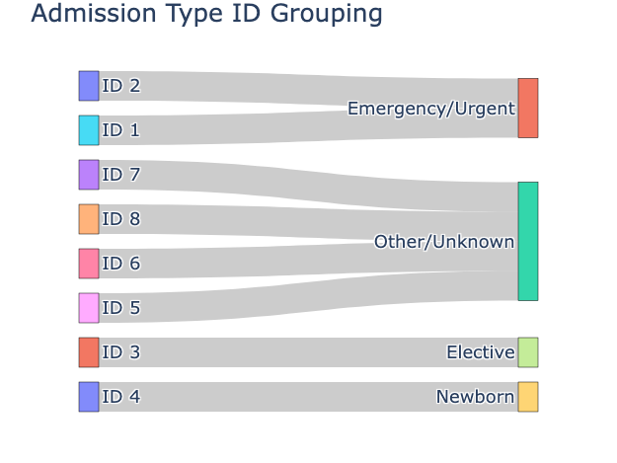
Reducing Categorical Features’ Dimensionality
Many categorical features had high cardinality, leading to increased complexity and potential overfitting.
Example Grouping: admission_type_id
Reduced to
admission_type_id | 8 | 4
admission_source_id | 25 | 5
discharge_disposition_id | 30 | 5
Contained numerous detailed categories that were not significantly distinct for prediction
Urgent
Emergency
Method: To reduce dimensionality while preserving meaningful distinctions, categorical variables were grouped by merging similar categories based on clinical and predictive relevance
Trauma Center
Not Mapped
diag_1 | ## | 9
diag_2 | ## | 9
diag_3 | ## | 9
Hundreds of unique ICD-9 codes, making them difficult to interpret and use in modeling.
NaN
Not Available
Elective
Method: Instead of handling hundreds of unique ICD-9 codes, diagnoses were grouped into 9 disease categories based on clinical significance (See Appendix)
Newborn
Notes:
Terry

Slide 7
Engineering Features for Risk Signaling for Readmission
To enhance risk signaling for hospital readmission, we engineered additional features by leveraging domain knowledge.
Medication Management
Patient Risk Profile
on_multiple_meds | Binary indicator for patients on 3+ medications
med_changes_total | Count of medication changes (increases or decreases)
insulin_binary | Flag for patients using insulin
age_risk | Age risk
risk_score Composite risk score by this formula: risk_score = w_A+(w_I×2)+(w_E×1.5)+(w_M×1.2) | Age risk
 | Inpatient history (weighted x2)
 | Emergency visits (weighted x1.5)
 | Medication count (weighted x1.2)
Hospital Utilization
Admission Characteristics
total_visits | Sum of outpatient, emergency, and inpatient visits
repeated_emergency | Flag for patients with multiple emergency visits
all_usage | Flag for patients who utilized all three care settings
is_emergency | Binary indicator for urgent/emergency admissions
Medication Management
on_multiple_meds: Binary indicator for patients on 3+ medications
med_changes_total: Count of medication changes (increases or decreases)
insulin_binary: Flag for patients using insulin
Hospital Utilization:
total_visits: Sum of outpatient, emergency, and inpatient visits
repeated_emergency: Flag for patients with multiple emergency visits
all_usage: Flag for patients who utilized all three care settings
Patient Risk Profile:
age_risk: Age-based risk stratification (1-5 scale)
risk_score: Composite risk score combining:
Age risk
Inpatient history (weighted x2)
Emergency visits (weighted x1.5)
Medication count (weighted x1.2)
Admission Characteristics
is_emergency: Binary indicator for urgent/emergency admissions
Notes:
Terry
Key Engineered Features
Medication Management
on_multiple_meds: Binary indicator for patients on 3+ medications
med_changes_total: Count of medication changes (increases or decreases)
insulin_binary: Flag for patients using insulin
Hospital Utilization
total_visits: Sum of outpatient, emergency, and inpatient visits
repeated_emergency: Flag for patients with multiple emergency visits
all_usage: Flag for patients who utilized all three care settings
Patient Risk Profile
age_risk: Age-based risk stratification (1-5 scale)
risk_score: Composite risk score combining:
Age risk
Inpatient history (weighted x2)
Emergency visits (weighted x1.5)
Medication count (weighted x1.2)
Admission Characteristics
is_emergency: Binary indicator for urgent/emergency admissions
These features transform raw clinical data into actionable risk indicators that capture complex patterns in patient care, medication management, and utilization history.

Slide 8
Class Imbalance & Modeling Approach

Slide 9
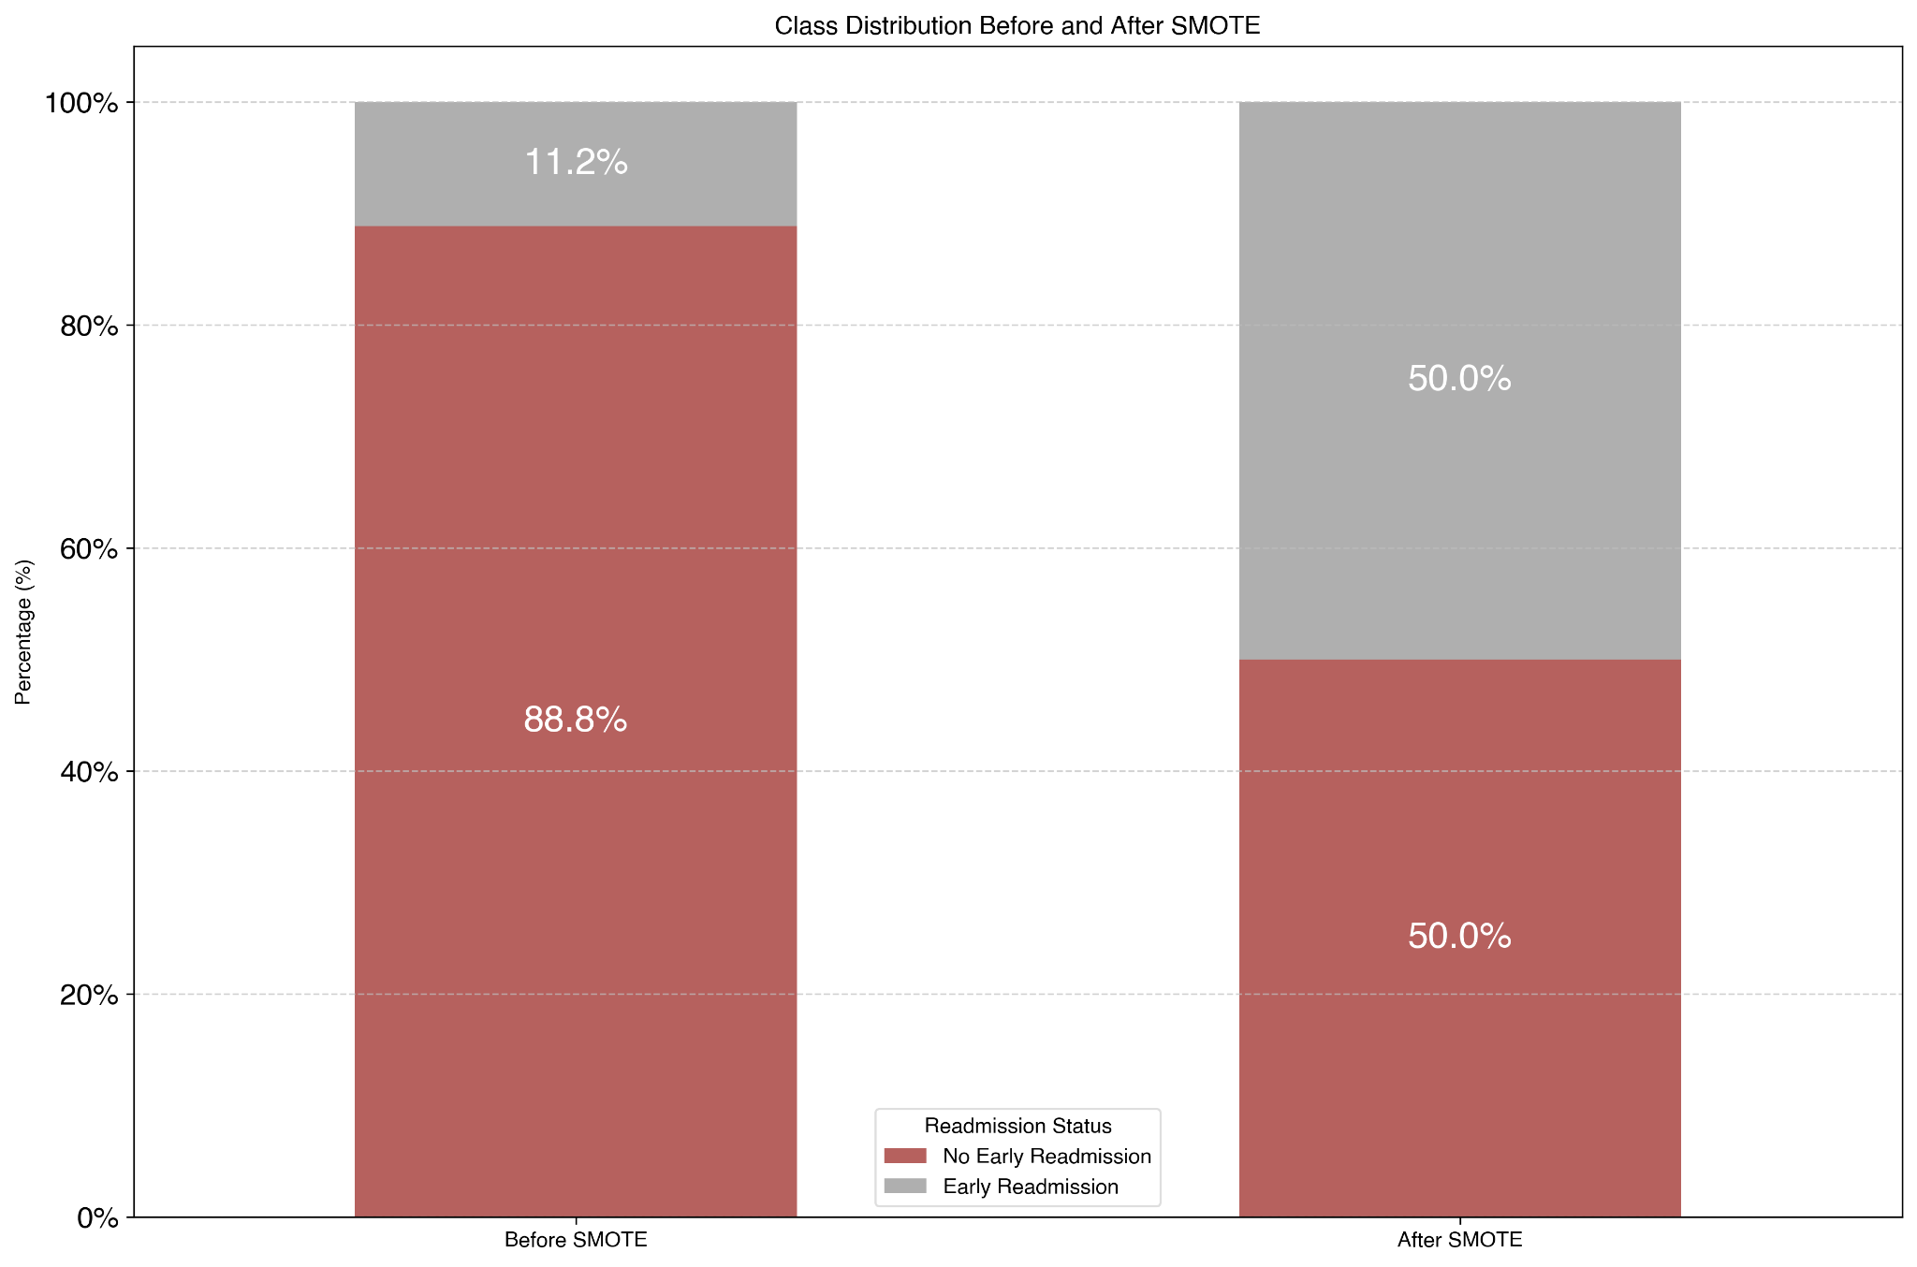
Class Imbalance in Readmissions – A Challenge for Prediction
Standard models assume balanced data, causing poor predictive performance on the minority class (readmissions)
A model could achieve high accuracy by defaulting to the majority class (non-readmissions), missing high-risk patients
Class Imbalance Before v.s. After SMOTE
SMOTE (Synthetic Minority Oversampling Technique) | Generates synthetic samples for the minority class → can lead to overfitting
Class Weights | Helps models tune performance in predicting the minority class → sensitive to outliers
Using SMOTE and class weights together can sometimes degrade performance due to compounding biases and overfitting
Notes:
Joey
Predicting readmissions is critical for patient care as well as hospital and insurance costs.
The model may predict "Not Readmitted" for most cases and still achieve high accuracy.
Generating additional ‘samples’ helps our model learn on more data that would approximate readmitted patients
Data leakage: avoided by applying SMOTE to training data only
Understanding the cons of generating

Slide 10
Evaluating SMOTENC & Class Weights Across Models
We will test both SMOTENC and Class Weights across multiple models to assess their effectiveness in handling class imbalance.
Model | Purpose | Strengths
Logistic Regression | Baseline model | Simple, interpretable
Random Forest | Uses bagging to reduce variance | Effective for class imbalance, improves generalization
XGBoost | Corrects errors iteratively | Captures complex relationships, improves minority class performance
LightGBM | Gradient boosting optimized for speed | Handles large datasets efficiently, reduces overfitting
CatBoost | Boosting method optimized for categorical features | Works well with categorical data, less hyperparameter tuning needed
Notes:
Joey

Slide 11
Hyperparameter Tuning
Notes:
Sarthak

Slide 12
Framework for Developing Models for Cost-Optimal Readmission Prevention
Hyperparameter tuning per model iteration
Model calibration to real world probabilities
Threshold tuning in accordance with financial assumptions*
Baseline Models
Hyperparameter Tuning
Calibration
Threshold Tuning
Best Performing Models
Logistic Regression
Ensuring each model is optimized independently for predictive performance (F2)
Adjusting probability outputs so they align with actual readmission rates
Selecting decision thresholds to optimize cost effectiveness in readmission reduction
F2 Optimization
Best Financial Performance
Random Forest
XGBoost (SMOTE)
XGBoost
XGBoost (Class Weights)
LightGBM
CatBoost (Class Weights)
CatBoost
* Tuning hyperparameters in accordance with financial assumptions is computationally expensive and would require re-tuning whenever costs change. We agreed on starting with finding the hyperparameters that achieve the best F2 score
Hyperparameter tuning per model iteration
Ensuring each model is optimized independently for predictive performance
Model calibration to real world probabilities
Adjusting probability outputs so they align with actual readmission rates
Threshold tuning in accordance with financial assumptions*
Selecting decision thresholds to optimize cost-effectiveness in readmission reduction
* Tuning hyperparameters in accordance with financial assumptions is computationally expensive and would require re-tuning whenever costs change. Let’s start with finding the hyperparameters that achieve the best F2 score
Notes:
Terry

Slide 13
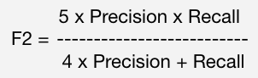
Tuning our Models for Predicting Readmission
Hyperparameter Tuning
Maximize F2 Score (favoring recall to prioritize flagging at-risk patients)
Metric Selection Rationale - Choosing the Right Metric for Imbalanced Data
Recall: Measures how many actual positives were correctly identified
F2 score : Prioritizes recall over precision
Parameters
1.
Learning rate
Controls how quickly models adapt to errors
2.
Tree depth
controls complexity of individual trees
3.
Regularization parameters
prevents overfitting
Outcome
Optimized for identifying at-risk patients but doesn’t align with financial outcomes
Hyperparameter Tuning
Goal: Hyperparameters
Learning rate → controls how quickly models adapt to errors
Tree depth → controls complexity of individual trees
Regularization parameters → prevents overfitting
Outcome: Optimized for identifying at-risk patients but doesn’t align with financial outcomes
Notes:
Sarthak

Slide 14

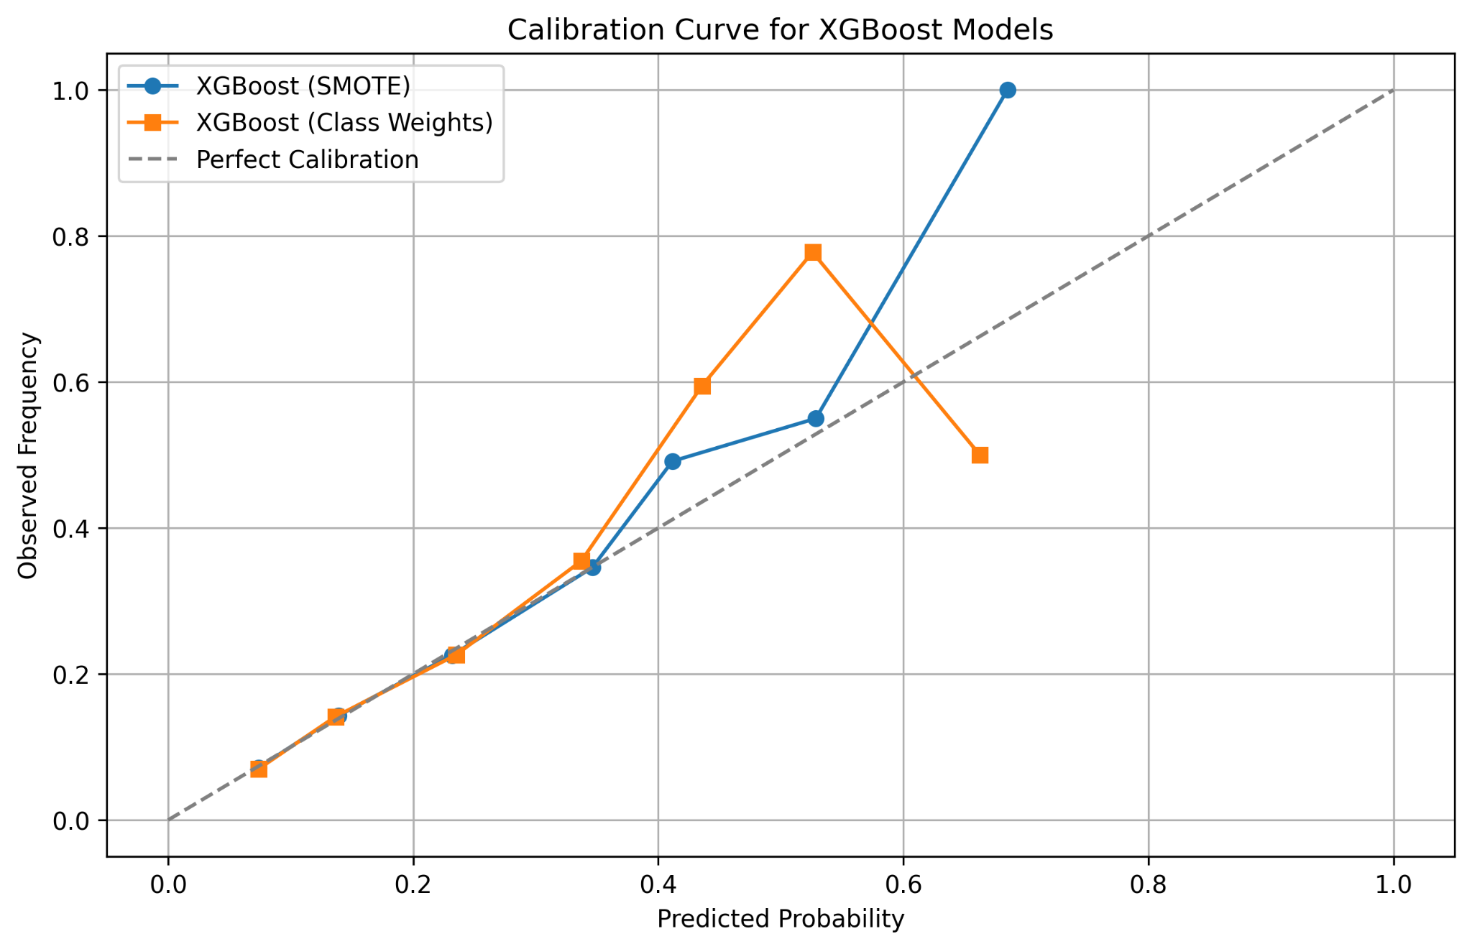
Why Probability Calibration Matters in Clinical Settings
Calibration
A correction technique that aligns predicted probabilities with actual observed outcomes
Why is calibration needed?
XGBoost Calibration Analysis
For hospital readmission models, improperly calibrated probabilities from models could lead to over- or under-predicting readmission risk, impacting patient care and financial costs.
As seen in the XGBoost calibration curve, both models overestimate probabilities at high confidence levels, leading to overconfident predictions that may mislead decision-making.
How is calibration done?
Calibration Curve for XGBoost Models
Isotonic Regression | Non-parametric method that finds a non-decreasing function to map predicted probabilities to calibrated ones via: CalibratedClassifierCV or Custom wrapper (for CatBoost)
Takeaway: These models work well for general predictions, but clinical decision-making requires precise probability calibration to avoid over/underestimating risk.
Why is calibration needed?
For hospital readmission models, improperly calibrated probabilities from models could lead to over- or under-predicting readmission risk, impacting patient care and financial costs.
What is calibration?
A correction technique that aligns predicted probabilities with actual observed outcomes
How is calibration done?
: non-parametric method that finds a non-decreasing function to map predicted probabilities to calibrated ones via CalibratedClassifierCV or custom wrapper (for CatBoost)
XGBoost Calibration Analysis: As seen in the XGBoost calibration curve, both models overestimate probabilities at high confidence levels, leading to overconfident predictions that may mislead decision-making.
Takeaway: These models work well for general predictions, but clinical decision-making requires precise probability calibration to avoid over/underestimating risk.
Notes:
Sarthak

Slide 15
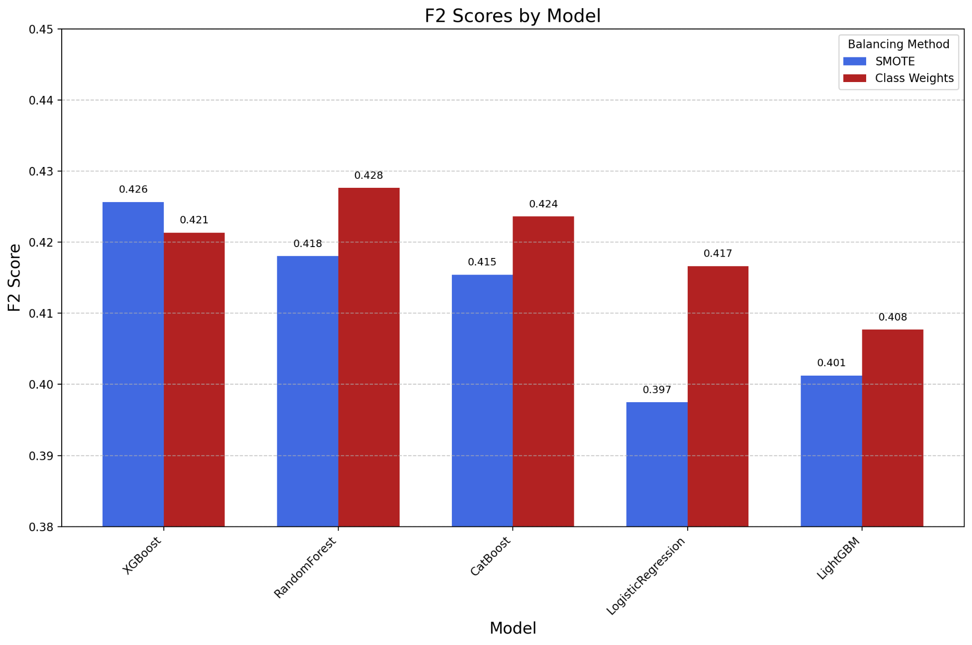
Evaluating Model Performance: The Precision-Recall Tradeoff
Insights
F2 Scores by Model
Class Weights outperform SMOTE on average
4 out of 5 models (Random Forest, CatBoost, Logistic Regression, and LightGBM)
RandomForest delivers the highest F2 scores
Excels with class weighting, hurt by SMOTE
Weighing Model Performance Against Clinical Application:
Optimizing F2 score led to probability thresholds classifying patients at risk for readmission between:
Probability Threshold | 0.08 | 0.10
Insights:
SMOTE outperforms class weight on average
4 out of 5 models (Random Forest, CatBoost, Logistic Regression, and LightGBM)
RandomForest delivers the highest F2 scores
Excels with class weighting, hurt by SMOTE
Weighing Model Performance Against Clinical Application:
Optimizing F2 score led to probability thresholds classifying patients at risk for readmission between (0.08 - 0.10)
Why is calibration needed?
XGBoost Calibration Analysis
For hospital readmission models, improperly calibrated probabilities from models could lead to over- or under-predicting readmission risk, impacting patient care and financial costs.
As seen in the XGBoost calibration curve, both models overestimate probabilities at high confidence levels, leading to overconfident predictions that may mislead decision-making.
How is calibration done?
Isotonic Regression | Non-parametric method that finds a non-decreasing function to map predicted probabilities to calibrated ones via: CalibratedClassifierCV or Custom wrapper (for CatBoost)
Notes:
Sarthak

Slide 16
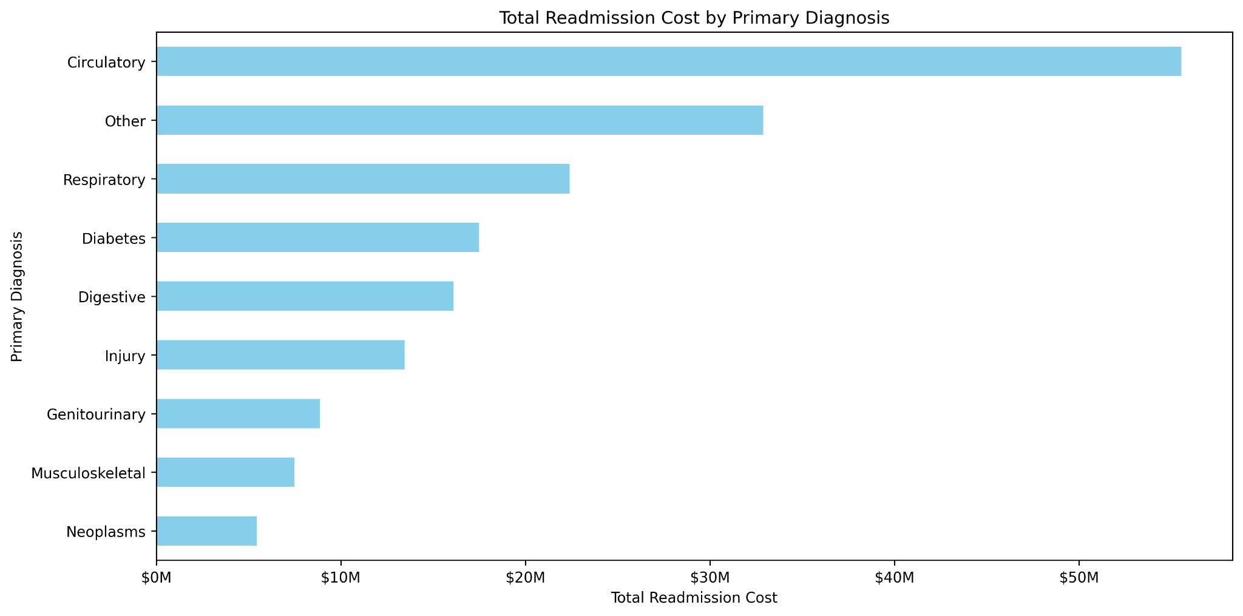
Incorporating Cost-Benefit Optimization – Threshold Tuning
Financial assumptions
Avg. Each Readmission Costs the Healthcare System | $16,300
Translates to $180M spent across the scope of this project
Per Patient Intervention Costs the Healthcare System | $2,500
The equivalent an extra night spent in the hospital
Intervention effectiveness (IE) | [30%, 40%, 50%] reduction in readmission risk
Total Readmission Cost by Primary Diagnosis
Healthcare savings
By preventing IE(%) of true readmissions ($16,300 each) while spending $2,500 on each high-risk patient (both correct and false alarms).
Savings = (TP × IE × $16,300) - ((TP + FP) × $2,500)
Financial assumptions:
On average each readmission costs the healthcare system $16,300
Translates to $180M spent across the scope of this project
Assuming intervention costs the healthcare system $2,500 per patient (the equivalent an extra night spent in the hospital)
Intervention effectiveness: 30% reduction in readmission risk
Healthcare savings:
By preventing IE% of true readmissions ($16,300 each) while spending $2,500 on each high-risk patient (both correct and false alarms).
IE = [30%, 40%, 50%]
Savings = (TP × 30% × $16,300) - ((TP + FP) × $2,500)
Notes:
Andrew

Slide 17
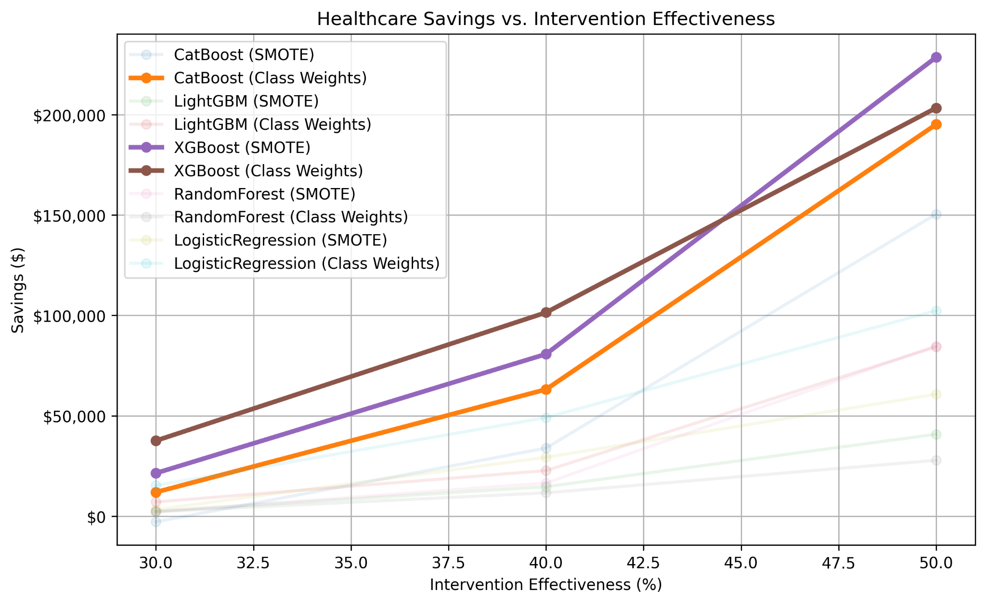
Evaluating Model Performance: Financial Impact
Threshold Testing
Tests threshold for each model assigning the threshold that maximizes healthcare costs savings
Consistent Performer (Preferred Model)
Healthcare Savings vs. Intervention Effectiveness
XGBoost (Class Weights)
Offers consistent savings at all intervention levels
Delivering the Highest Savings ($)
XGBoost (SMOTE)
Reaching $200,000 Savings | @ 50% Intervention Effectiveness
Takeaways: SMOTE Models underperform on average – Class weighting works better than oversampling for financial gains at modest intervention effectiveness levels
Higher intervention effectiveness → savings
Savings increase as effectiveness rises from 30% to 50%
Notes:
Andrew

Slide 18
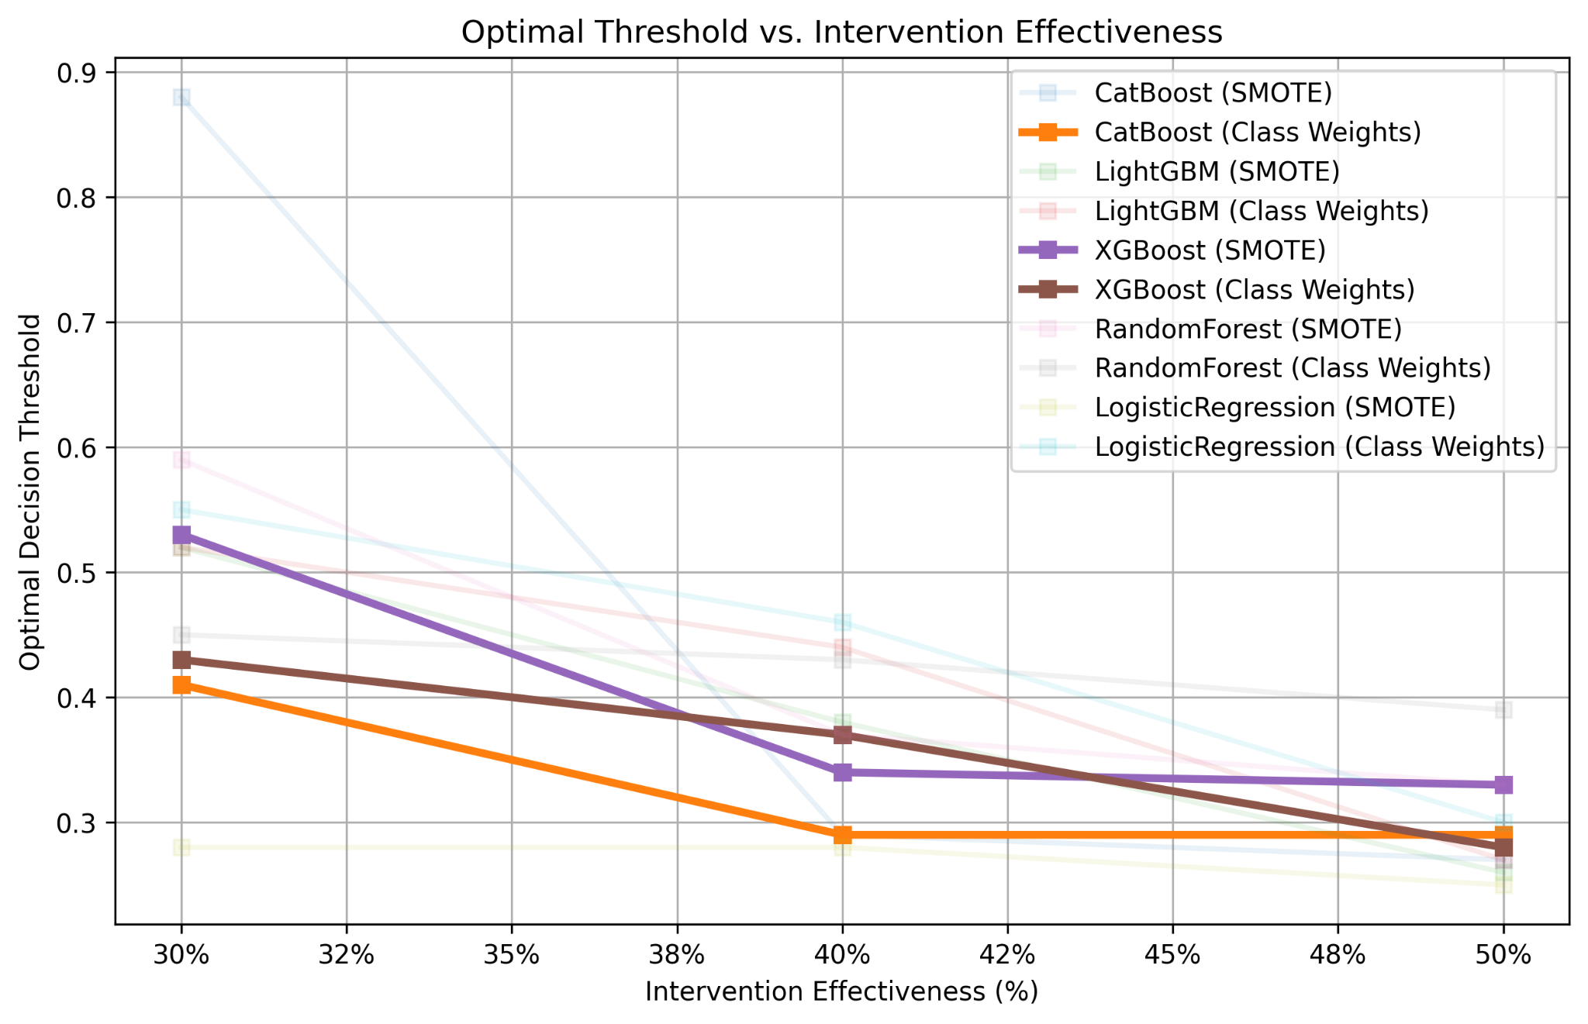
Optimizing Decision Thresholds for Preventing Hospital Readmissions Using XGBoost
XGBoost – increases financial performance while lowering the threshold for intervention support as effectiveness increases
Takeaway: Most models take a conservative approach to preventing readmissions at first
At 30% effectiveness, many models start with high decision thresholds (~70%), meaning they only intervene in high-risk cases to prevent unnecessary costs.
Models lower their decision thresholds as intervention effectiveness rises from 30% to 50%, allowing more interventions
Optimal Threshold vs. Intervention Effectiveness
Preferred Model
XGBoost (Class Weights) | Effectively adjusts decision thresholds in response to increasing intervention effectiveness Ensuring an optimal balance between cost savings and patient interventions XGBoost (Class Weights) strikes a better balance—lowering thresholds sooner while maintaining financial efficiency.
Notes:
Andrew

Slide 19
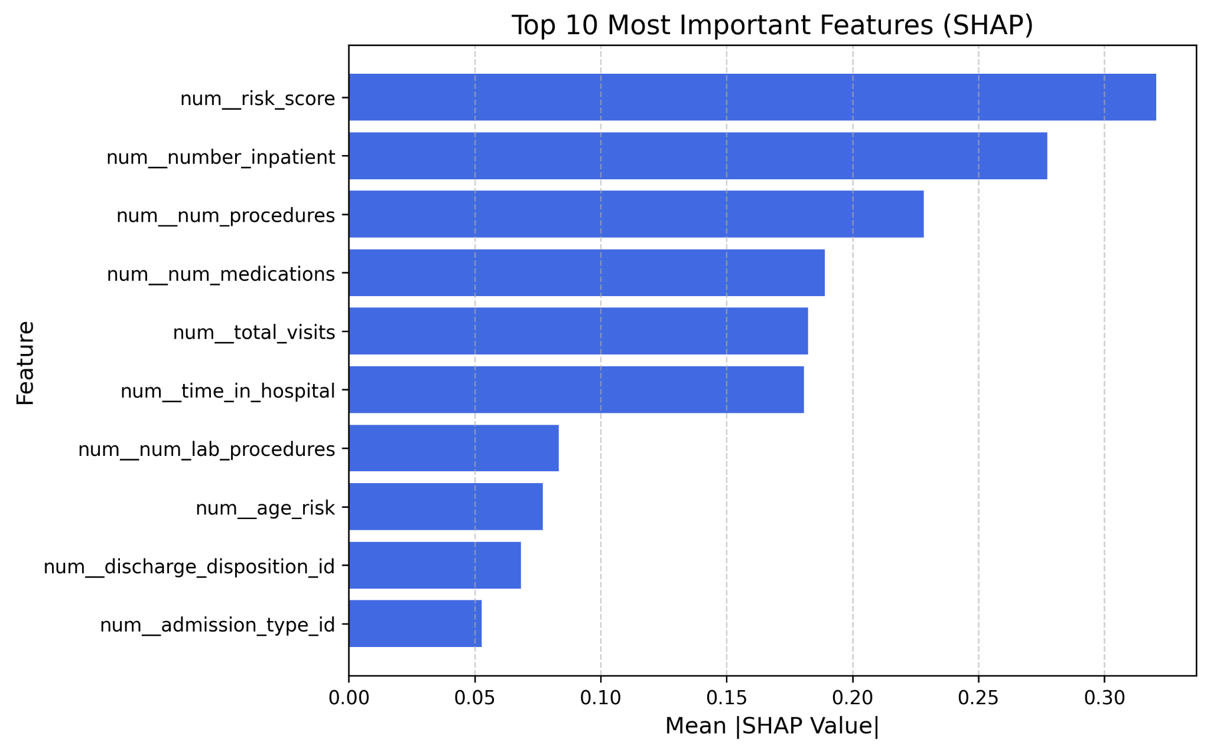
Feature Importance – Risk Score, Key Indicator of Readmission
SHAP(Shapley Additive Explanations)
Top 10 Most Important Features (SHAP)
SHAP values measure how individual features impact the model’s prediction.
Higher SHAP values indicate a stronger influence on hospital readmission risk
Takeaways
Risk score and inpatient visit history contribute most to readmission prediction
Lab procedures and discharge disposition may provide additional predictive power.
Notes:
Andrew

Slide 20
Implementation Plan

Slide 21
Implementation Plan: Integrating Predictions for Readmission Prevention
Implementation Timeline
Remaining Modeling Plan
Completed
Stage 1
Stage 2
Stage 3
Further model calibration
Accurate risk probabilities
Threshold tuning for region-specific financial constraints
Identify disparities in model performance
demographic
patient groups
Ongoing
Data Exploring
Modeling
Detailed Tuning
Integration
Planned
WEEK:
1-3
4-5
6-9
10-13
14-16
17+
Exploring Data Analysis
Data Processing & Engineering
Implementation Plan
Data Pipeline & System Integration
Automate data ingestion from hospital systems (e.g. Epic, Cerner)
Model Deployment
Develop and implement a real-time prediction API to assess patient risk near discharge, including explainable outputs from the production model
Clinical Workflow Integration
Embed predictions into discharge planning systems, working as an aid for healthcare professionals to evaluate discharge plans
Monitoring & Continuous Improvement
Monitor model drift and performance and evaluate against cost-benefit framework
Model Selection & Hyperparameter Tuning
Midway Report
Additional After Feedback Modeling
Model Integration
Notes:
Terry

Slide 22
Additional Modeling Considerations
Limitations | Recommendations
Black-box models hinder interpretability in high-dimensional data. | Use advanced visualization techniques (e.g., parallel coordinates, Andrews curves).
Inconsistent feature importance across algorithms creates ambiguity. | Develop complementary rule-based models alongside black-box methods.
Using global class weights may ignore intra-group imbalance (e.g., across age groups, gender). | Apply feature-aware class weighting based on important categorical variables.
Naive imputation may not capture domain-specific nuances. | Apply Bayesian imputation with domain-inspired priors.
Raw probability outputs may be misinterpreted due to over-/under-confidence issues. | Integrate recalibration (e.g., isotonic regression) and explanation tools (e.g., SHAP).
Notes:
Sarthak

Slide 23
Thank you

Slide 24
Appendix

Slide 25
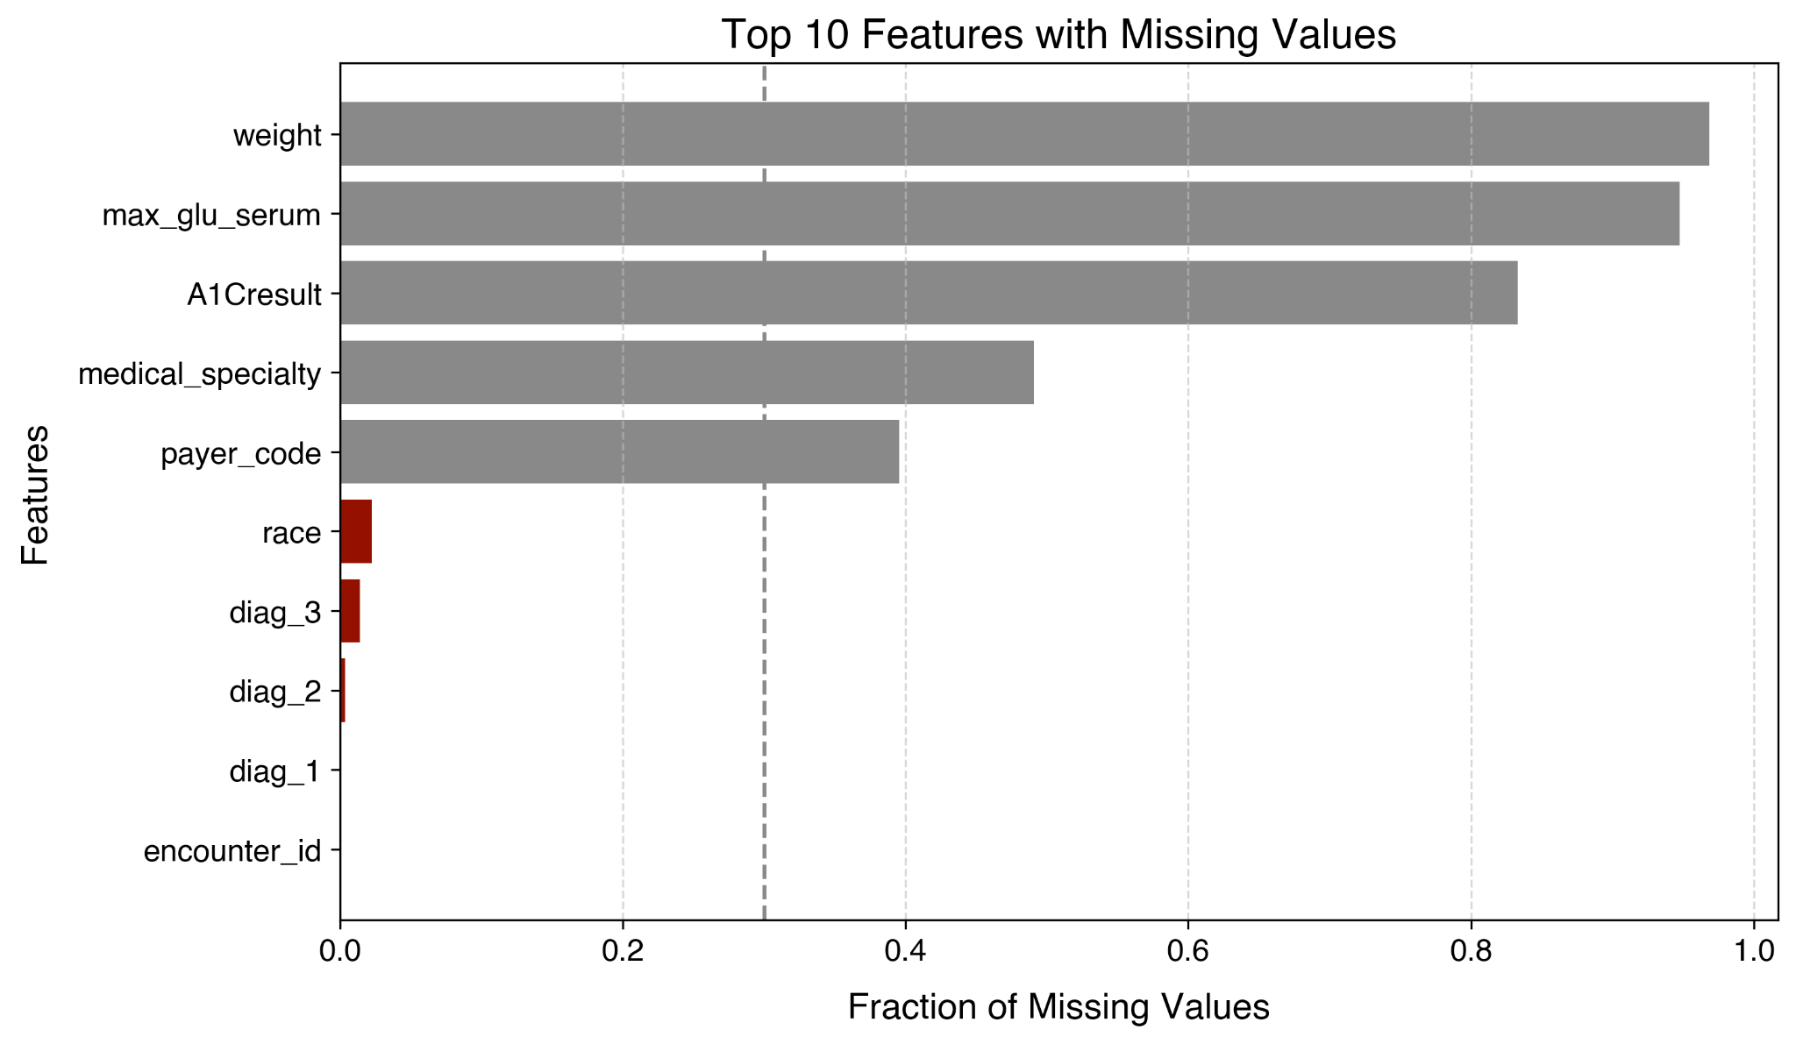
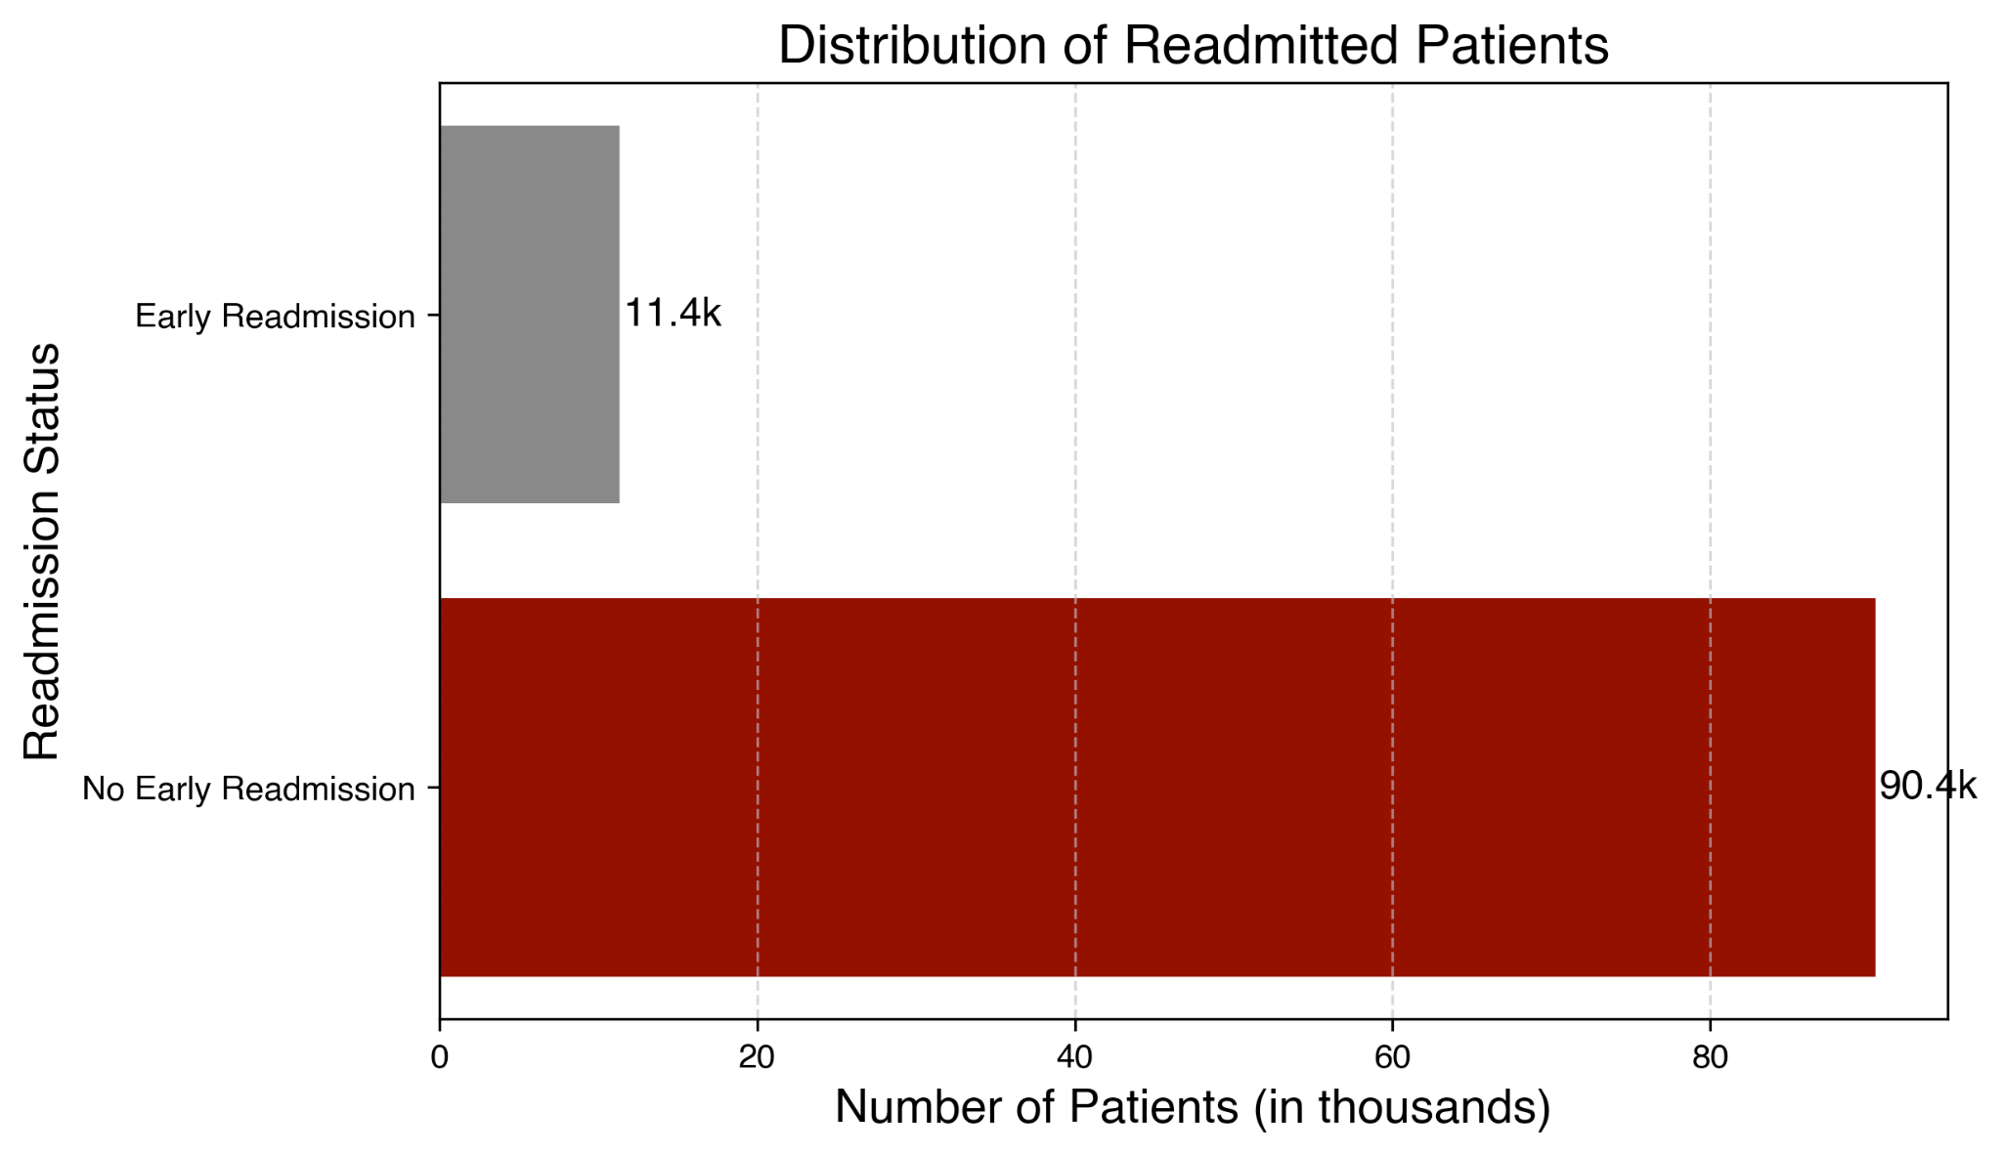
Data Overview – Quality & Target Variable
Addressing Data Quality
Target Variable Early Hospital Readmission
5 features with significant missing data
Dropped rows with <3% missing data
~11% of patients with diabetes readmitted within 30 days, suggesting class imbalance

Slide 26
Alternative Method: LLM Driven Readmission Predictions
Performance in predicting readmission patients
 | Precision | Recall
No Early Readmission | 0.91 | 0.28
Readmitted | 0.09 | 0.71
Why experiment with LLM driven approach?
Traditional machine learning models suffer from class imbalance
Using llama3, readmission predictions can be made
Without feature selection, hyperparameter tuning
However, coming with potential drawbacks:
Higher computational requirements than traditional models
Potential data privacy concerns
Less interpretability
Lacks direct probability calibration

Slide 27
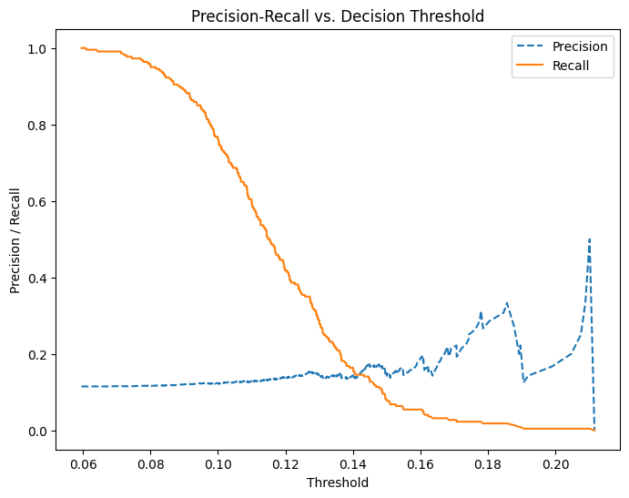
SVM
optimal parameter
C=0.1, gamma=1, kernel='rb
best decision boundary: 0.11

Slide 28
Storyboard
Class imbalance toolkit
SMOTE vs Class Weights
Model overview
Gradient Boosting vs Random Forest
XGBoost vs Catboost vs LightGBM
LLM & SVM
Hyperparameter optimization
Model calibration (clinical use, needs real probabilities)
Threshold tuning per F2
Threshold tuning against our cost function
financial assumptions
Review findings
Process of tuning to F2 vs financial outcomes
Discuss implementation
Ethical considerations
Notes:
Predicting readmissions is critical for patient care as well as hospital and insurance costs.
The model may predict "Not Readmitted" for most cases and still achieve high accuracy.
Generating additional ‘samples’ helps our model learn on more data that would approximate readmitted patients
Data leakage: avoided by applying SMOTE to training data only
Understanding the cons of generating

Slide 29
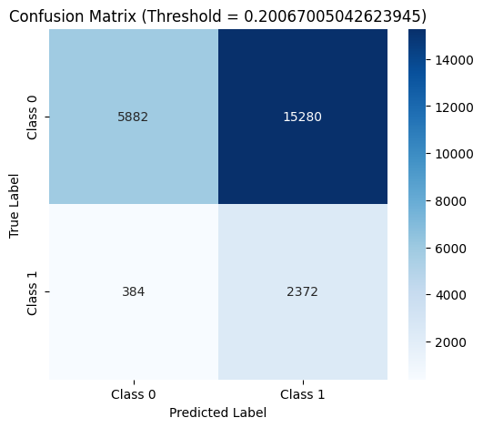
Financial Impact - Andrew

Slide 30
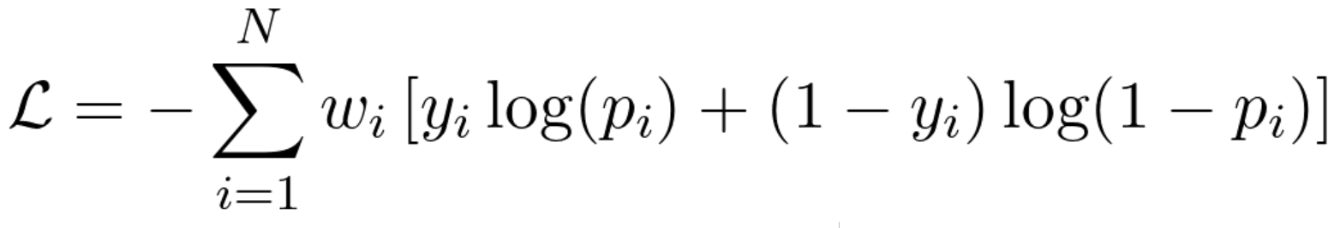
Class weighting preserves data distribution, while resampling distorts it, leading to unreliable predictions
Issues with Resampling Methods:
Oversampling:
Duplicates minority class samples → Leads to overfitting
Model learns an inflated positive class proportion → Overconfident predictions
No real improvement in model generalization
Undersampling:
Reduces majority class → Loss of valuable information
Model trained on less data → Weaker predictive power
Results in high variance & unreliable predictions
Class Weights: A better alternative
What are Class Weights?
Instead of changing the dataset, we adjust the model’s focus by scaling the loss function
Assigns higher penalty for misclassifying the minority class
Model learns the true distribution without artificially changing class proportions
Applied in XGBoost Loss Function:
For binary classification, the weighted logistic loss function is:
How it Helps?
Model does not overestimate positive class probability
Keeps the true class distribution intact
More balanced confidence estimates

Slide 31
Attempts to Reduce Dimensionality on Numerical Features
In the aim of reducing dimensionality, principal component analysis yields minimal results - most of the dimensionality should be reduced on the categorical variables
Feature Correlation Analysis:
Aim: Check for multicollinearity among selected features.
Most features were uncorrelated, except: number of medications & time in hospital showed weak positive correlation
Decision: No need to drop addition features
Principal Component Analysis:
Aim: Reduce feature space while preserving maximum variance
Results:
3 PCA components explain ~50% variance
4 PCA components explain ~66% variance
One-hot encoding on categorical features would introduce upwards of 2,000 features

Slide 32
Model Selection - Hyperparameter Tuned Results
Models | F2-Score | Recall (1) | Precision (1) | Recall (0) | Precision (0)
Random Forest (Optimal Threshold: ~0.20) | 0.414 | 0.861 | 0.134 | 0.278 | 0.939
Logistic Regression
SVM with class weight (Optimal Threshold: ~0.15) | 0.135 | 0.131 | 0.148 | 0.894 | 0.906
LLM Model(Ollama) | 0.294 | 0.716 | 0.091 | 0.283 | 0.915
XGBoost (Optimal Threshold: ~0.505) | 0.426 | 0.770 | 0.150 | 0.450 | 0.940

Slide 33
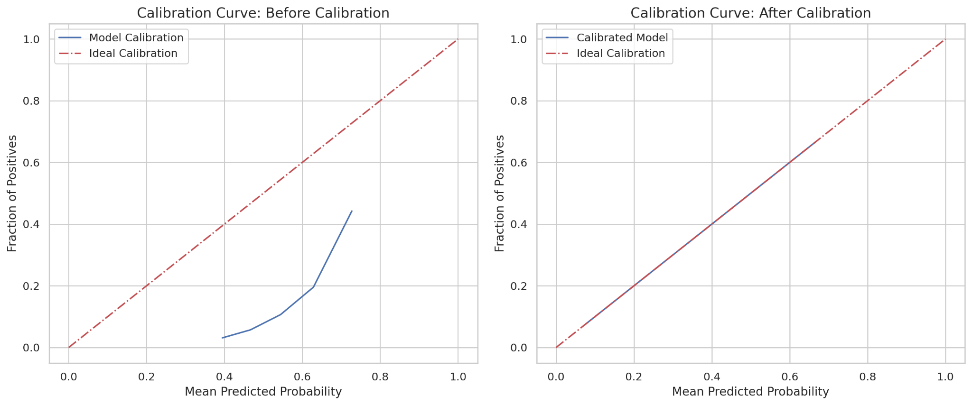
Result of Recalibration
Prior to calibration the model was overconfidence, but as the mean probability increases the prediction align more with the actual proportions. In the calibrated model, but the actual prediction and the proportion are aligned.

Slide 34
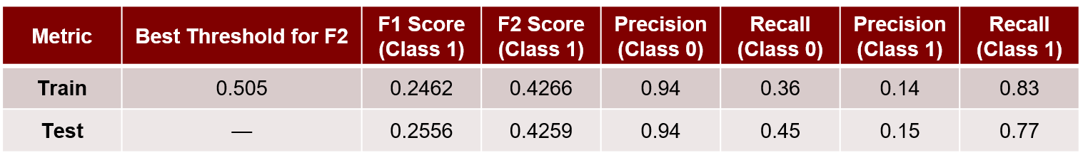
Threshold tuning helps improve model performance in imbalanced datasets by optimizing F2 score
The default threshold of 0.5 may not be optimal in the case of imbalanced data, as the model tends to predict the negative class more frequently. Therefore, we need to tune the threshold to improve performance on the chosen metric for our specific problem. In this case, we tune the threshold to maximize the F2 score.

Slide 35
Choosing the Right Metric for Imbalanced Data
Problems with Conventional Metrics
Accuracy is misleading
Predicting all as "No Admission" → 88% Accuracy
But misses all high-risk patients
F1 Score treats all errors equally
We need to prioritize recall
Type 2 Error is More Costly !
Type 1(False positives) → Extra monitoring
Type 2(False negatives) → Missed Risk
Severe complications if misclassified
Better Alternatives: Recall & F2 Score
Why Recall & F2 ?
Recall: Measures how many actual positives were correctly identified
F2 score : Prioritizes recall over precision
Formula Comparison
F1 = 2 x Precision x Recall
—------------------------
Precision + Recall
F2 = 5 x Precision x Recall
—-----------------------
4 x Precision + Recall
Small icon or graphic showing "False Negative" leading to hospitalization vs. "False Positive" leading to extra checkup

Slide 36
Building a Robust Model for Readmission Prediction
In case if additional rows needed feel free to add models here:
Model | Baseline Modeled Results (F2) | Purpose | Strengths

Slide 37
Building a Robust Model for Readmission Prediction
Predictions will be based on an ensemble model combining outputs from multiple models, learning the optimal way to combine and give accurate predictions.
Model | Baseline Modeled Results (F2) | Purpose | Strengths
Random Forest | 0.121 | Uses bagging to reduce variance | Effective for class imbalance, improves generalization
ExtraTreesClassifier | 0.115 | Combines multiple decision trees with high randomness | Robust to overfitting, handles complex patterns in imbalanced data
Gradient Boosting (XGBoost, LightGBM, AdaBoost) |  | Corrects errors iteratively | Captures complex relationships, improves minority class performance
SVM with Class Weights | 0.134 | Finds optimal decision boundaries | Works well in high-dimensional spaces, focuses on minority class
Logistic Regression with SMOTE |  | Baseline model with synthetic data balancing | Simple, interpretable, improves dataset balance

Slide 38
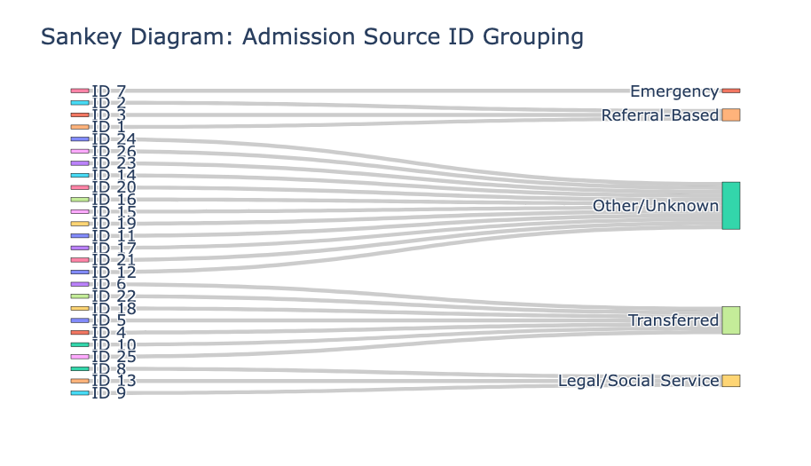
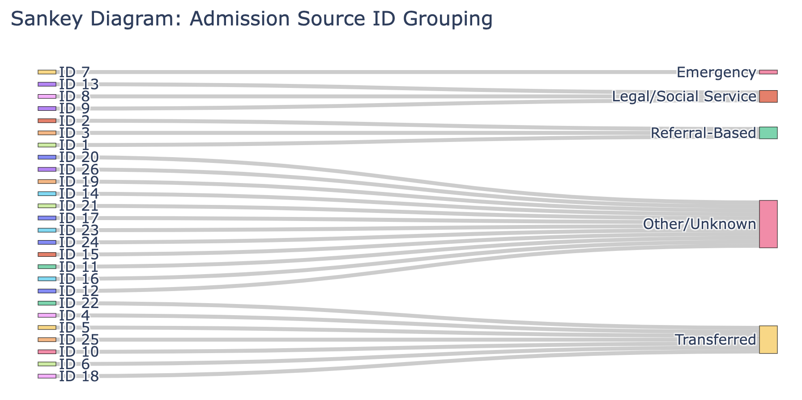
Data Processing - Reducing Categorical Features’ Dimensionality
Contents: Tree Visual for demonstrating how things were grouped and one sentence with short bullets for explaining
For reducing complexity, reducing dimension of the admission_source_id from 25 sources to 5 sources
Combine physician, clinic, HMO referral into a single category (e.g., "Referral-Based").
Combine transfers from hospital, SNF, healthcare facilities and anything transfer related into a single category (e.g., "Transferred").
Keep emergency room admission as its own category since it hold distinct importance, (e.g., “Emergency”).
Combine court/law enforcement, social services into a single category (e.g., "Legal/Social Service").
Combine other miscellaneous or unknown sources into a single category (e.g., "Other/Unknown").

Slide 39
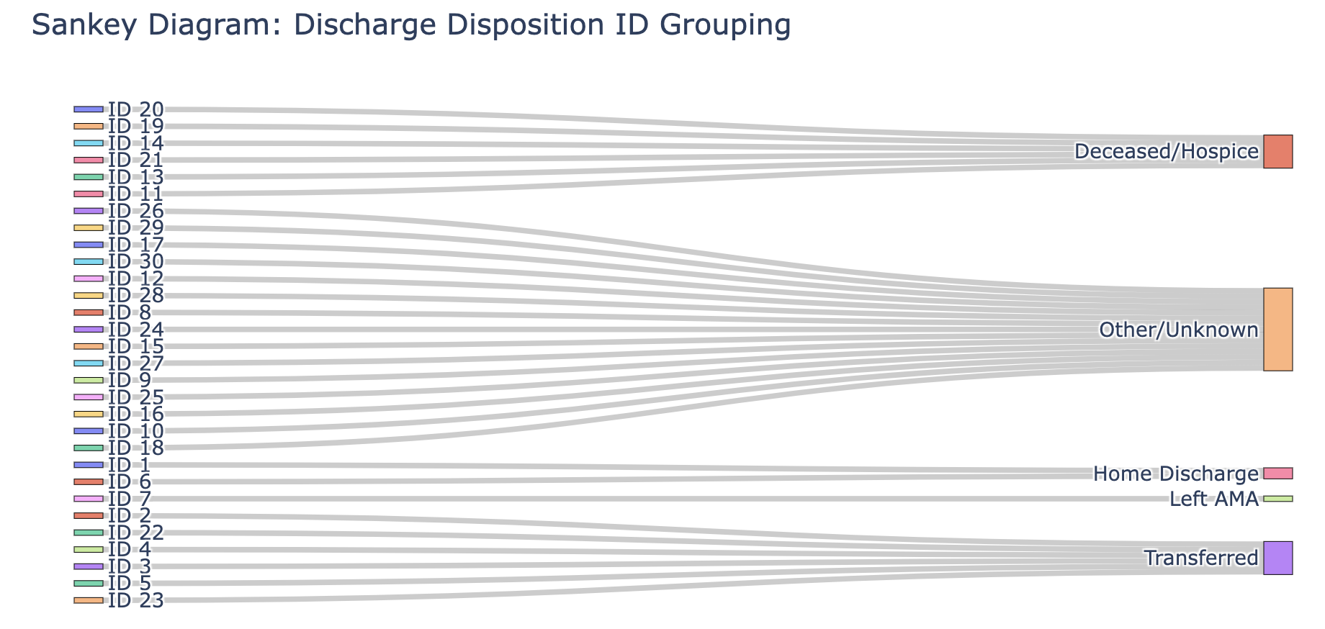
Data Processing - Reducing Categorical Features’ Dimensionality
Contents: Tree Visual for demonstrating how things were grouped and one sentence with short bullets for explaining
For reducing complexity, reducing dimension of the discharge_disposition_id from 30 dispositions to 5 dispositions
Combine home and home with health service into a single category (e.g., "Home Discharge").
Combine transfers to other healthcare facilities into a single category (e.g., "Transferred").
Keep left against medical advice (AMA) as its own category since it hold distinct importance, (e.g., “Left AMA”).
Combine deceased or hospice care into a single category (e.g., "Deceased/Hospice").
Data points with discharge disposition of “Deceased/Hospice” were removed in later cleaning since the objective is to predict readmissions, those patients who died during this hospital admission were excluded. Patients who passed away or hospiced cannot be readmitted.
Combine other miscellaneous or unknown cases into a single category (e.g., "Other/Unknown").

Slide 40
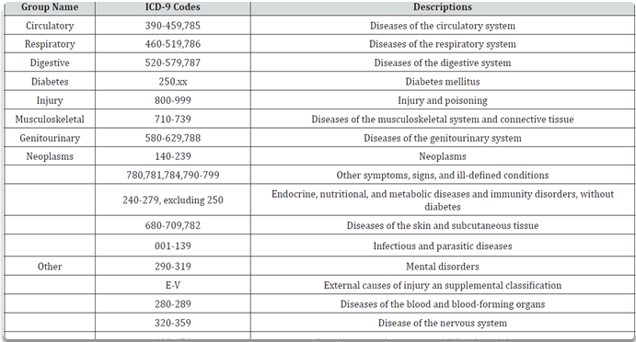
Data Processing - Decoding & Grouping Diagnosis By Disease Categories for Better Interpretability

Slide 41
Which Medications Are Important in Prediction?
Problem
20+ medications included in the data
Patients can have extensive history of medications prescribed
Medications Selected:
Solution
Metformin
Repaglinide
Glipizide
Insulin
Reduce the medication features to the list that help predict early readmission
Approach
Statistical tests for class discrimination (Chi-square)
Filter out medications with extreme class imbalance (e.g., if 95% of patients fall in one category)

Slide 42
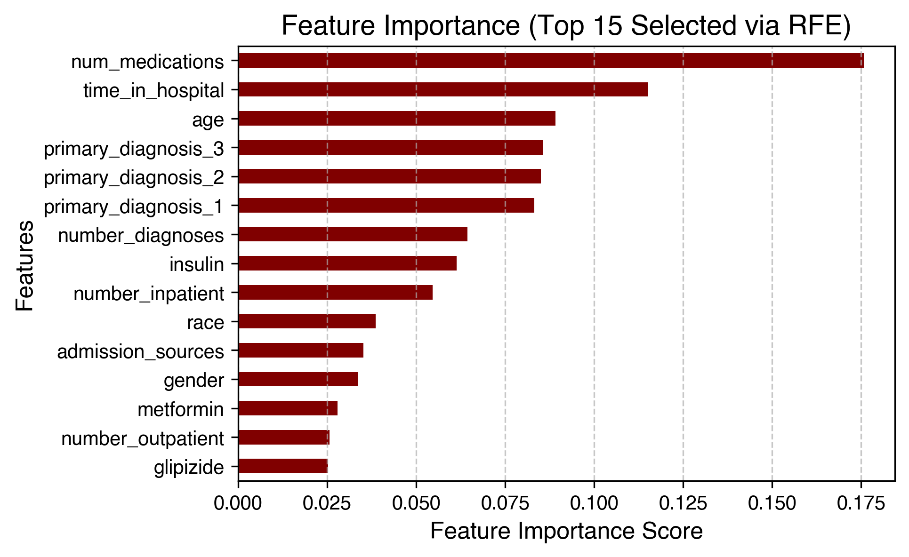
Additional Feature Selection – 2 Layer Robust Approach
Problem
40 features after data processing
High dimensionality can lead to overfitting and decreased model performance.
Need for a systematic approach to retain the most informative features.
Selected Features & Feature Importance By RFE
2 Layer Robust Approach
Step 1: Filter Method - SelectKBest with Mutual Information
Identifies top features using mutual information, which measures the relevance of each feature to the target.
Selects the top 30 features based on their MI scores.
Step 2: Wrapper Method - Recursive Feature Elimination (RFE) with Random Forest
Uses Random Forest to iteratively remove the least important features.
Reduces features from 30 to top 15 most relevant features.
Notes:
Mutual Information (MI) measures the dependency between each feature and the target variable. It captures non-linear relationships and helps identify the most relevant predictors. The SelectKBest function selects the top k features based on their MI scores.
Algorithm of Mutual Information Classifier
MI measures how much knowing one variable reduces uncertainty about another.
Higher MI scores indicate stronger relevance of the feature to the target variable.
MI is non-parametric and works well with categorical and continuous variables.
The features are ranked based on MI scores, and only the top k are selected.
Wrapper Method: Recursive Feature Elimination (RFE) with Random Forest
RFE is a wrapper method that iteratively removes the least important features based on model performance. Random Forest is used here due to its ability to rank features by importance and handle non-linearity.
Rationale for Using RFE with Random Forest
Random Forest assigns importance scores to features based on how much they improve model performance.
RFE eliminates the least important features in a recursive manner.
This step further reduces dimensionality after initial filtering by SelectKBest.

Slide 43
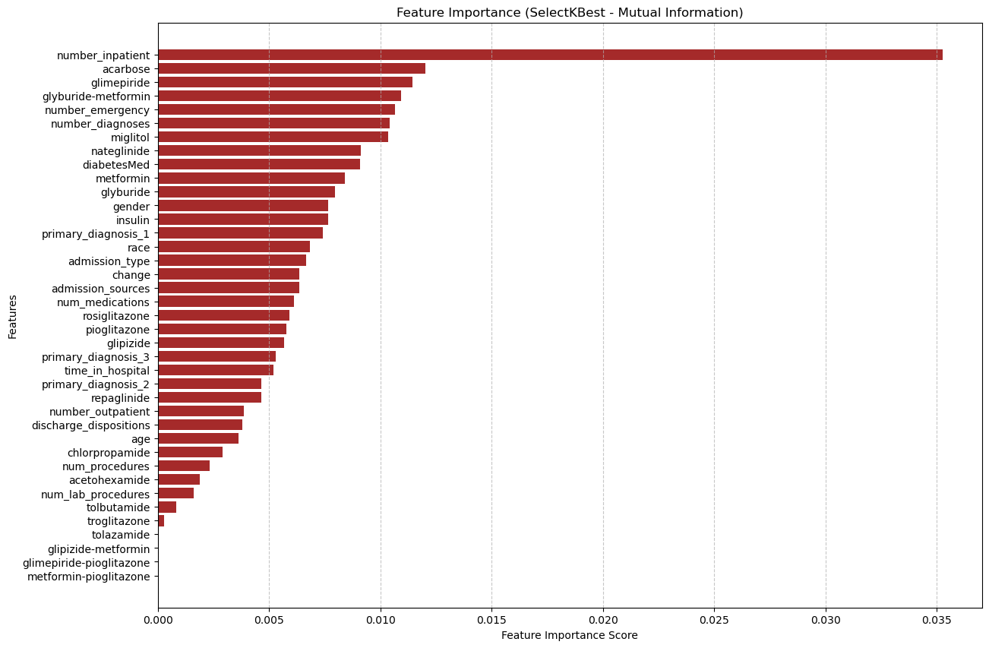
Feature Rankings (1st Order Feature Selection Through Filtering)

Slide 44
Feature Rankings (2nd Order Feature Selection Through Wrapping) - Random Forest Ensemble

